Slide 1
Principles of AI Engineering Chapter 2: System with Machine Learning
Prof. Dr. Steffen Herbold
Credit:
Based on contents from Christian Kästner (https://github.com/ckaestne/seai)

Slide 2
Contents
The role of ML in a system
Model goals vs. system goals
Embedding ML systems in the real world
Human-AI interaction
Operating production ML systems
Deductive and inductive reasoning
Managing software complexity

Slide 3
The role of ML in a System
Notes:
(8 min)

Slide 4
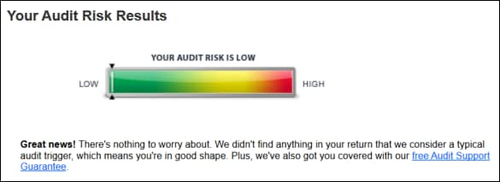
Machine learning as a small feature in a system
https://ttlc.intuit.com/community/choosing-a-product/help/about-the-audit-risk-meter/00/25924
Augments a working system with an additional optional feature

Slide 5
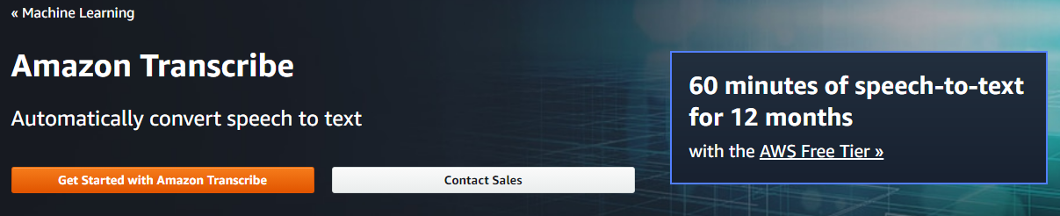
Machine learning as a core component
https://aws.amazon.com/transcribe/
Enables a new product and is a major selling point

Slide 6
… but in both cases a fairly small part of the system
System: Tax software with audit risk prediction
System: transcrAIbe
User Interface
User Interface
User Accounts
Tax Computation
Audit Risk Prediction
User Accounts
Audio Upload
Payment
Speech Recognition
Database
Payment
Logging
Monitoring
Database
Cloud Processing
Logging
Monitoring

Slide 7
Many examples of ML in production
Product recommendation on Amazon
Surge price calculation for Uber
Inventory planning at Walmart
Search for new oil fields by Shell
Smart app suggestion on Android
Social profiling for placing advertisments by Facebook
…

Slide 8
Model-centric vs. system-wide focus
Focus on:
Building models for given a given data set
Evaluation of the accuracy of the model
Traditional model focus (data science):
Model Requirements
Data Collection
Data Labeling
Data Cleaning
Feature Engineering
Model Training
Model Evaluation
Typical machine learning book

Slide 9
Model-centric vs. system-wide focus
Focus on:
Experimenting
Deploying
Scaling training and serving
Model monitoring and updating
Automating pipelines and MLOps (ML engineering)
Model Requirements
Data Collection
Data Labeling
Data Cleaning
Feature Engineering
Model Training
Model Evaluation
Model Deployment
Model Monitoring
Cloud, scaling
Cloud, scaling
Focus of MLOps
Full pipeline automation

Slide 10
MLOps infrastructure
Data Verification
Machine Resource Management
Serving Infrastructure
Monitoring
Configuration
Data Collection
ML Code
Analysis Tools
Feature Extraction
Process Management Tools
ML Code only a small part of the MLOps code!
Note: Amount of other code depends a lot on tooling. Modern cloud platforms provide many aspects “out of the box”.

Slide 11
View on ML-enabled system in production
Model Requirements
Data Collection
Data Labeling
Data Cleaning
Feature Engineering
Model Training
Model Evaluation
Model Deployment
Model Monitoring
System: transcrAIbe
User Interface
User Accounts
Audio Upload
Payment
Speech Recognition
Focus:
Interaction of ML and non-ML components
System requirements
User interactions
Delivering products
Database
Cloud Processing
Logging
Monitoring

Slide 12
Model goals vs. system goals
Notes:
(8 min)

Slide 13
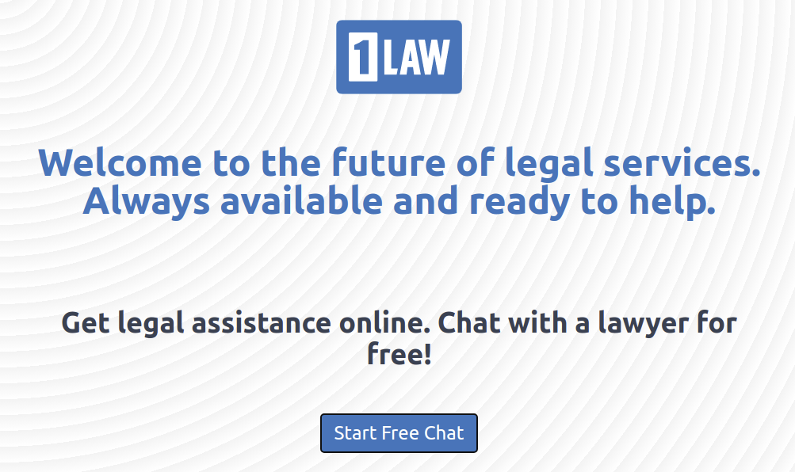
Case study: Self-help legal chatbot
https://www.1law.com/
Based on: Passi, S., & Sengers, P. (2020). Making data science systems work. Big Data & Society, 7(2).
Note: all screenshots on the next slides are for illustration and not from the actual system

Slide 14
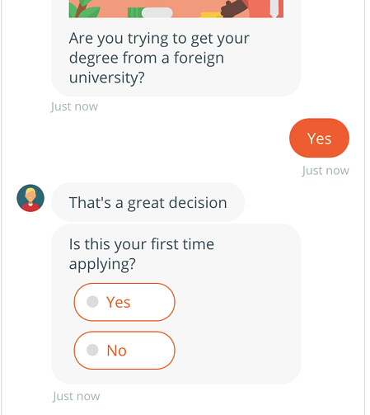
Previous system: Guided chat
Pre-defined set of questions and answer
Often multiple choice
Just think of the guidance at telefon hotlines until you get to speak to a human
Hard to match pre-defined content to open questions
„Please state your topic“ allows many ways to phrase an answer!
Old-fashioned
Common solution:
If automation fails, involve a human early
→ Expensive!

Slide 15

Initial vision
Paul (director of technology of Law&You):
People in legal chat do not always follow a script. We want to find ways to anticipate conversational pathways. We are agnostic to technology as long as it provides value—user information. (Fieldwork Notes, 31 July 2017)
We need a
better chatbot!
Help users with simple tasks
Connect them with lawyers when needed
Modernize appearence

Slide 16
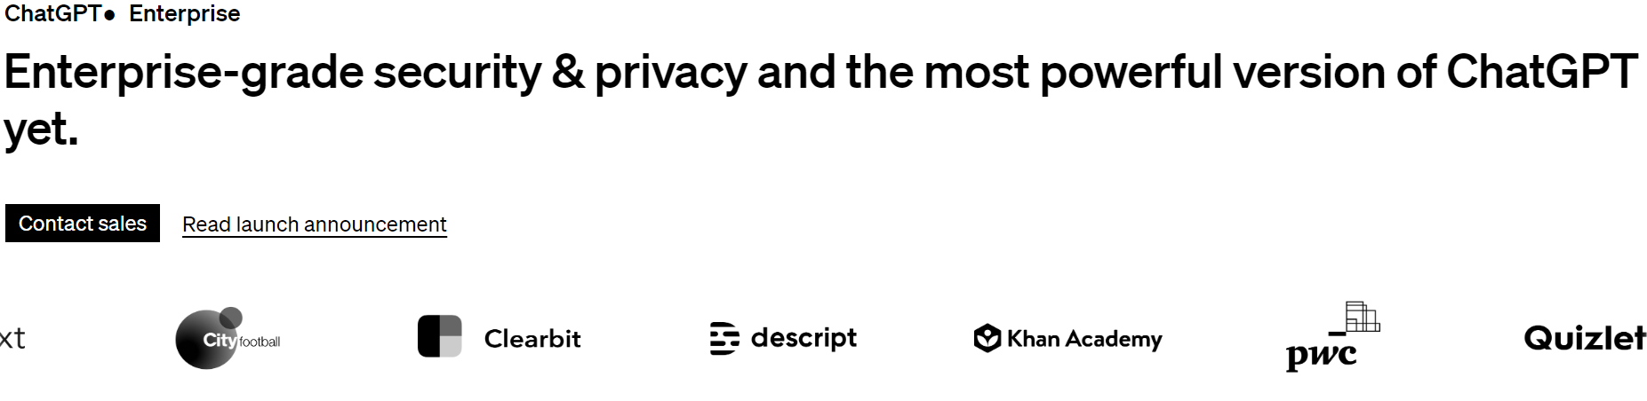
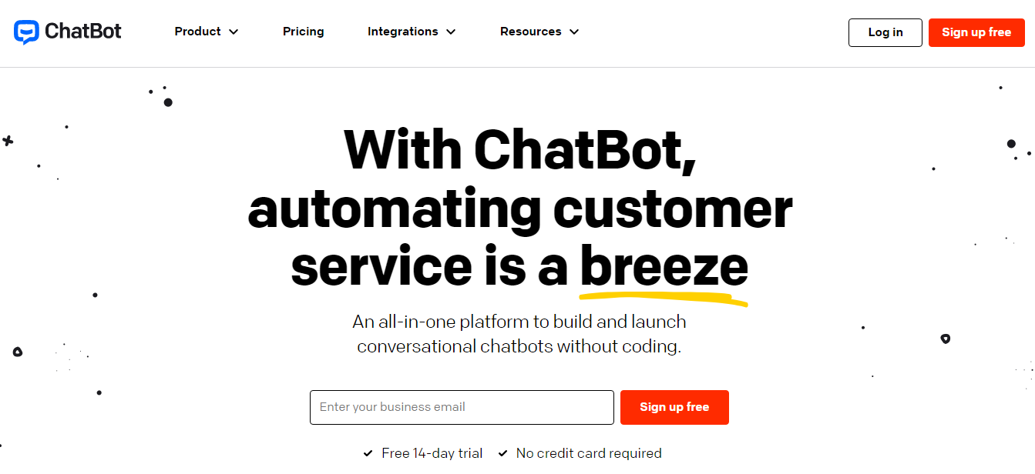
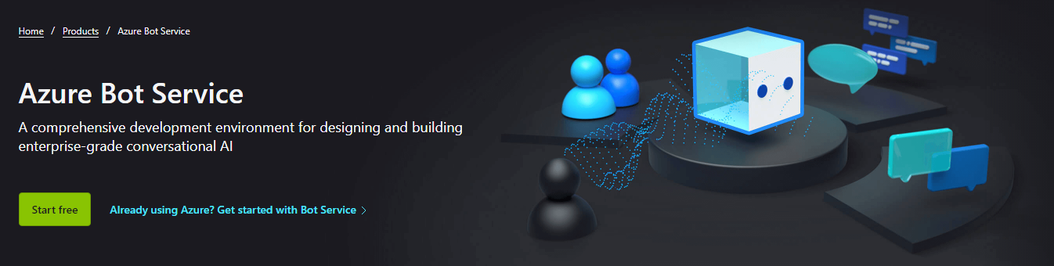
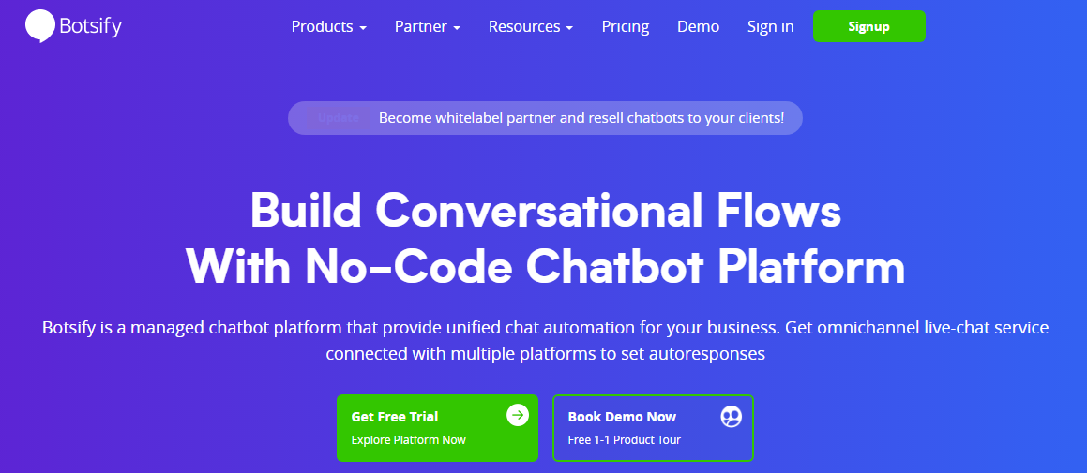
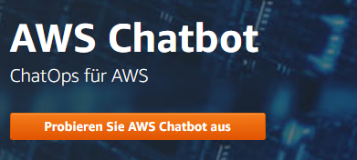
Buy or build?!
https://openai.com/enterprise
https://www.chatbot.com/
https://azure.microsoft.com/services/bot-services
https://botsify.com/
https://aws.amazon.com/chatbot/

Slide 17
Data science challenges
Infrastructure
Understand chat bot infrastructure and capabilities
Knowing topics
Identify what users talk about
Train/test concepts with past chat logs
Guiding conversations
Support for open-ended conversations
Requires detecting topic and finding a good response
Intent modeling!
Is talk about parents and children on topic when discussing divorce?
→ Many corner cases!

Slide 18

Live exercise
What are the system goals?
How are the data science challenges related to them?

Slide 19

Status meeting
Maybe we need to think about it like an 80/20 rule. In some cases, it works well, but for some, it is harder. 80% of everything is fine, and in the remaining 20%, we try to do our best.
The trouble is how to automatically recognize what is 80 and what is 20.
I agree. Let us focus on that. We just want value. Tech is secondary.
It is harder than it sounds. One of the models is a matching model trained on pairs of legal questions and answers. 60,000 of them. It seems large but is small for ML.
That’s a lot. Can it answer a question about say visa renewal?
Paul
Director of Technology
If there exists a question like that in training data, then yes. But with just 60,000, the model can easily overfit, and then for anything outside, it would just fail.
Remy
Director of Data Science
I see what you are saying. Edge cases are interesting from an academic perspective, but for a business the first and foremost thing is value. You are trying to solve an interesting problem. I get it. But I feel that you may have already solved it enough to gain business value.

Slide 20

System goals for the chatbot
Collect user data and sell to lawyers
Signal technical competency to lawyers
Acceptable to fail!
If the conversation is too complicated for the bot, connect with lawyer
Solving edge cases is not important
Paul: Edge cases are important, but the end goal is user information, monetizing user data. We are building a legal self-help chatbot, but a major business use case is to tell people: ‘here, talk to this lawyer.’ We do want to connect them with a lawyer. Even for 20%, when our bot fails, we tell users that the problem cannot be done through self-help. Let us get you a lawyer, right? That is what we wanted in the first place.

Slide 21

Accuracy is not everything in practice!
“Good enough” may be good enough
Prediction critical for the system or just a gimmick?
Costs for better predictions are important
May need way more data, much longer training times
May need other types of data and raise privacy concerns
User interfaces can help mitigate many problems
“User Experience” (UX) matters often more than predictions
Using high confidence predictions can help offset issues

Slide 22
Benchmark vs. production
In 2012, researchers already complained about the focus on benchmarks in ML
Standard benchmarks not directly related to real-world problems (Iris, MNIST, ImageNet, …)
Focus on abstract metrics, not real-world impact
Accuracy instead of Return on Investment (ROI)
Lack of follow-through with deployments in real-world use cases
Ignores important design choices
How to collect data
What problem to solve
Design of the human-AI interface
This got worse since then!
E.g., good Large Language Model (LLM) evaluations are extremely difficult, because the benchmarks are getting less and less representative
Wagstaff, Kiri. "Machine learning that matters." In Proceedings of the 29 the International Conference on Machine Learning, (2012).

Slide 23
Embedding ML systems in the real world
Notes:
(8 min)

Slide 24




Systems thinking
(Software) System
Component
Component
Environment
(incl. users, physical world)
Component
Component
Component
Consider how your system as a whole interacts with the world!

Slide 25

Example 1: Speech recognition
Interactive web application:
Users see transcription and can correct mistakes
System: transcrAIbe
User Interface
User Accounts
Audio Upload
Payment
Speech Recognition
Environment
Database
Cloud Processing
Logging
Monitoring
Upload of video an audio files
Optional:
Integration into live streams

Slide 26
Example 2: Audit risk
Static reporting of results. No interaction.

Slide 27
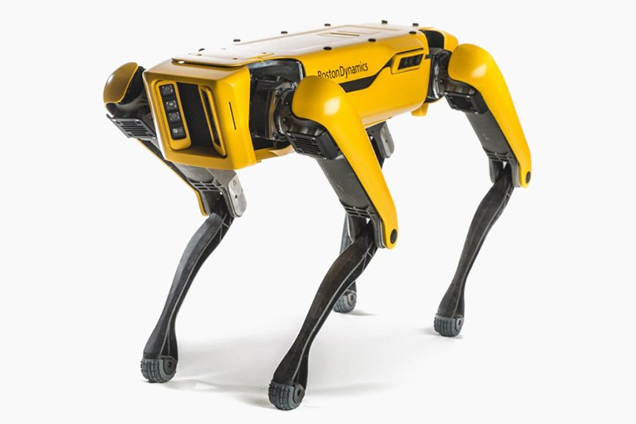
Example 3: Robotics
Spot by Boston Dynamics
Observes and actively interacts with physical environment

Slide 28
System ←→ World feedback loops
ML
Model
Historic bias
Data
Predictions
Influence
Can encode, enforce, and even enhance existing bias!

Slide 29
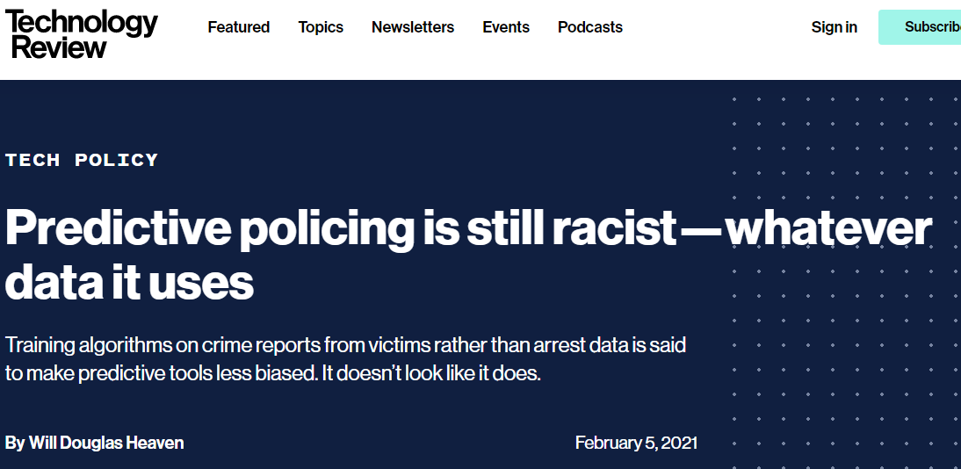
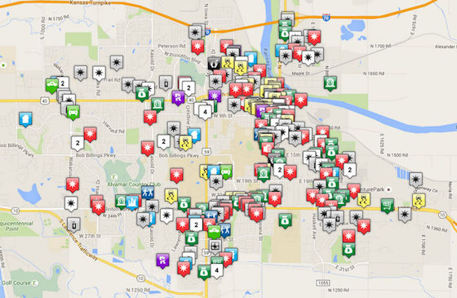
Example 4: Predictive policing
Guide police patrols based on past crime rates
https://www.technologyreview.com/2021/02/05/1017560/predictive-policing-racist-algorithmic-bias-data-crime-predpol/
… really bad idea …

Slide 30


ML predictions have consequences
Positive
Assistance
Productivity
Creativity
Negative
Manipulation
Polarization
Discrimitnation
AI Engineering must be responsible!

Slide 31
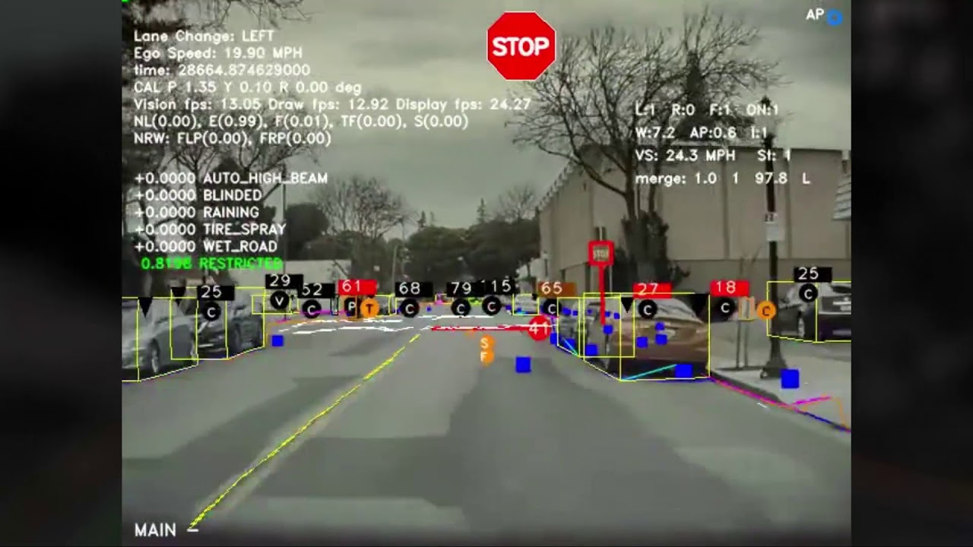
Safety is a system property
Code or models do not harm people directly
The systems in which they are used might
Example: Computer Vision
Always safe if you download the data and train/test models offline
→ Not embedded in a system
Was involved in traffic incidents when used to make decision on the road
→ Safety is an issue of the use in the system
https://www.youtube.com/watch?v=fKXztwtXaGo

Slide 32

Live Exercise: A smart toaster
Use machine learning to regulate toasting for optimal result
Safety goal:
Ensure that the smart toaster does not burn the kitchen
How can this be achieved?

Slide 33

Safety Assurance in the model vs. outside the model
Input
Input
May restrict input space
→ Avoid inputs from unknown regions
Safety box
ML input
Safe
ML model
ML model
Safe Output
ML output
May transform outputs
→ Replace unsafe ML outputs with safe outputs
Safe output
Model must ensure that the output is safe for every possible input
→ Model verification, hard and (currently) unsolved for most practical problems
Safety box must ensure that the output is safe for every possible input
→ Allows lightweight solutions

Slide 34
Safety box for the smart toaster
Software solution:
Post-process output and ensure a maximum toasting time
Hardware solution:
Install a thermal fuse
HW/SW solution
Install a temperatur sensor
Software initiates shutdown if temperature too high

Slide 35
Model vs system properties
Similar to safety, many other qualities should be discussed at model and system level
Security
Privacy
Transparency and accountability
Maintainability
Scalability
Energy consumption
Impact on system goals
…

Slide 36
Think about systems!
Holistic approach
Look at the big picture
Involve all stakeholders
Consider relationships and interactions between components and environment
Everything is interconnected
Combining parts creates something new with emergent behavior
Developers must understand the dynamics, be aware of feedback loops and the effect of actions
Understand how humans interact with the system

Slide 37
System-level challenges for ML-enabled systems
Getting (and updating) data and concept drift
Handling massive amounts of data
Interactions with the real world and feedback loops
Lack of modularity of AI components
Lack of specifications
Deployment and maintenance
Versioning, debugging, and incremental improvements
Keeping training and operation costs manageable
Interdisciplinary teams
Balancing system and model goals
…

Slide 38
Human-AI interaction
Notes:
(8 min)

Slide 39
Predictions influence the world
Product or music recommendations
Feed curation in social media and news
Image search engines
…
…
Smart homes
…
…
Self-driving cars
Robotic workers
Today!
Today?
Tomorrow?

Slide 40
Model outputs and user interactions
Design considerations
How much information should be revealed?
Suggestion with reason and likely consequence (do X because Y to achieve Z with a certain probability)
Suggestion with reason (do X because Y)
Suggestion (do X)
Automatically take action
How to influence the user towards the system‘s goal?
How to minimize the consequences of flawed predictions?
How to collect data to continue to learn from users and mistakes?
Requires balancing of (at least!) three system-level outcomes:
Achieving objectives
Protection from mistakes
Collecting data for training

Slide 41
Types of result presentations
Automation
Take action on user‘s behalf
Prompt
Ask the user if an action should be taken
Organize
Display a set of items in an order
Annotate
Add information to a display
Hybrids of these

Slide 42
Live Exercise: Self-driving car
What should the system achieve?
What are trade-offs?
Objectives?
Protection from mistakes?
Collecting data?
https://www.youtube.com/watch?v=fKXztwtXaGo

Slide 43
Operating production ML systems
Notes:
(8 min)

Slide 44
Things change …
Paper‘s published in 2021:
NeuroIPS: 2334
AAAI: 1692
ICLR: 860
ICML: 1184
CVPR: 1661
ACL: 1167
ICASSP: 1734
INTERSPEECH: 963
→ 11595 paper‘s at these venues in *one year*!
Newer, better models are released
Better model architectures
More training data
Goal and scope change
Support for new use cases
Model re-training due to drift
Changes in the environment
→ Should be supported by online experimentation!

Slide 45
Example: Speech recognition
System: transcrAIbe
New speech-to-text models
New words in language
Social developments
New concepts or products
Slang
Support for new domains
E.g., new research domains
New languages
Regional dialects
→ Observe how each change affects the system
User Interface
User Accounts
Audio Upload
Payment
Speech Recognition
Database
Cloud Processing
Logging
Monitoring

Slide 46
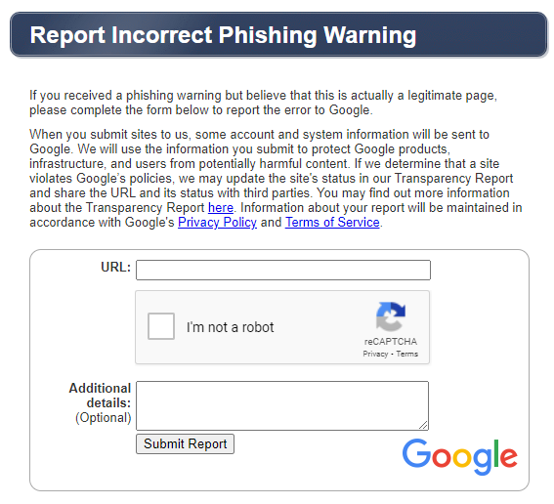
Monitoring in production
Design systems for telemetry
Example
Request active feedback on wrong predictions
https://safebrowsing.google.com/safebrowsing/report_error/?hl=en

Slide 47
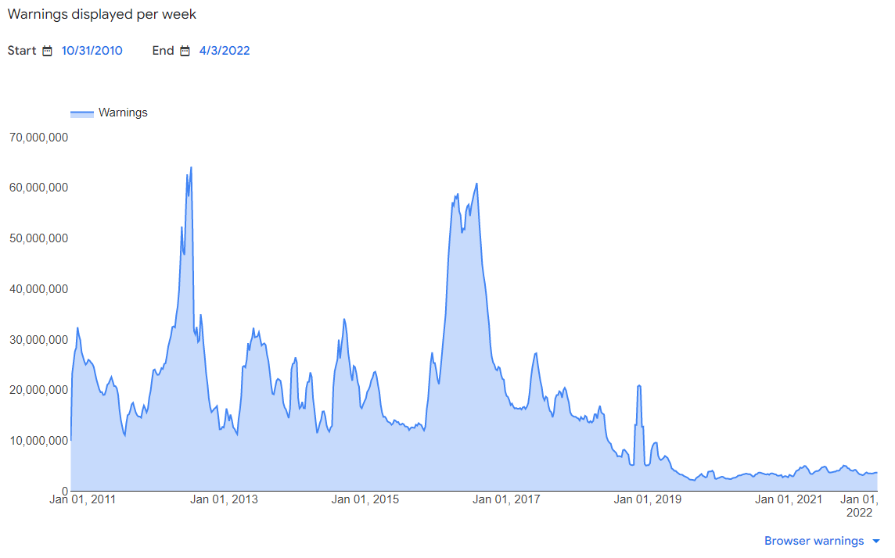
Using data improves the system!
Fewer visits to unsafe pages!
Decreased false positive rate?
Improved filtering during search?

Slide 48
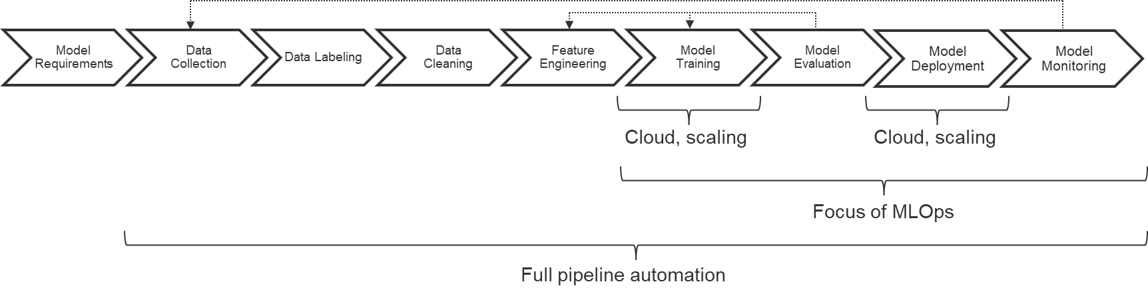
„Pipeline thinking“
System: transcrAIbe
End-User Interface
Internal Data Labeling Interface
telemetry
data collection
User Accounts
Audio Upload
Feature Server
share
Model Inference:
Speech Recognition
Design the system with the pipeline in mind
learns &
deploys
observes
Payment
Training Data
ML Pipeline
Model Monitoring
uses
triggers
scales by
observes
Database
Cloud Processing
Logging
Monitoring

Slide 49
Shift from model focus to pipeline focus
Modeling in a local environment
Model-centric workflow that allows rapid prototypical model development
Rarely robust infrastructure
Often monolithic and tangled
Shift to pipeline
Robust programs
Input data, infrastructure, nothing “hard coded”
Standardized and modular infrastructure
Cloud services, Kubernetes, libraries
Big conceptual leap that requires a different skill-set

Slide 50
Deductive and inductive reasoning
Notes:
(8 min)

Slide 51
Observations, paradigms, theories, and experiments
Inductive reasoning
Deductive reasoning
Observation or experiment
Exploratory
research
Confirmatory
research
Generalization
Prediction
Paradigm or theory

Slide 52
Deductive reasoning
Combining logical statements following agreed upon rules to form new statements
Examples
Proving theorems from axioms
From general to the particular
Sherlock Holmes solving cases
Formal methods, classic rule-based AI systems
Premise
Logical statements
Inference
If the premise is true, the inference is also true.

Slide 53
Inductive reasoning
Constructing axioms from observations
Examples
The score increases after the ball went into the goal → number of goals equal score
From particular to the general
Most modern machine learning systems, statistical learning
Observation / Evidence
Synthesis
Principle
Principle is probably true based on the evidence

Slide 54
Managing software complexity
Notes:
(8 min)

Slide 55
Methods to manage complexity
Abstraction
Hide details and focus on high-level behaviors
Reuse
Package into reusable libraries and APIs with well-defined contracts
Composition
Build large components out of smaller ones
(Software) System
Component
Component
Environment
(incl. users, physical world)
Component
Component
Component

Slide 56
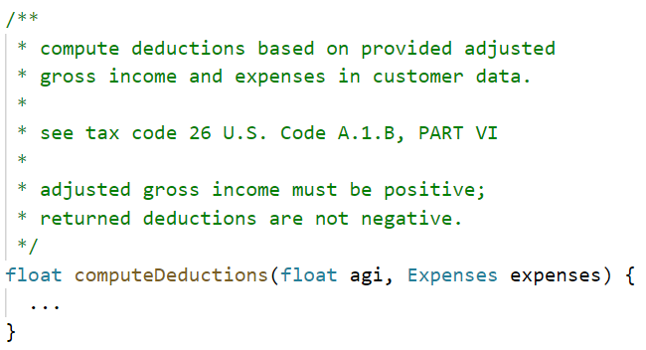
Example: Mangage complexity within code
Composition:
Small building block of a large system (e.g., audit risk assessment)
Reuse:
Comment defines API contract that specifies how this function can be reused
Abstraction:
No need to know how the deductions are computed to use this in a larger system

Slide 57

Divide and conquer
Human cognitive ability limited
Decomposition is necessary to handle complexity
Use deductive reasoning to understand how groups of smaller units of complexity work together as a system
Additional advantage:
Allows division of labor
Personal information
(e.g., income, dependents, …)
Tax return
Compute adjusted gross income
Compute deductions
Report taxes

Slide 58
Debugging and assigning blame
Each component has a specification
Defines for each input the expected output
Important for debugging!
Personal information
(e.g., income, dependents, …)
Wrong result
Tax return
Mistake here?
Mistake here?
Mistake here?
Compute adjusted gross income
Compute deductions
Report taxes

Slide 59

Strict correctness assumption
Specification determines which outputs are correct/wrong
No concept of “pretty good:”
Even 99,9% accuracy not acceptable
→ A single wrong result indicates a bug in the system
Personal information
(e.g., income, dependents, …)
Wrong result
Tax return
Compute adjusted gross income
Compute deductions
Report taxes

Slide 60
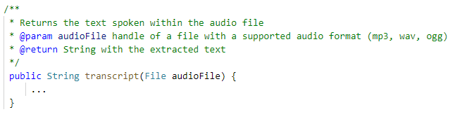


Lack of specifications
We cannot specify this!
Instead:
Inductive reasoning, i.e., machine learning
→ No (automated) rules that specify the correct output, other than our learned model!
Training data
Machine Learning
…
Model

Slide 61

Weak correctness assumption
Often no reliable ground truth
Usually human judgment
Expensive
Accepting that mistakes will happen, but hopefully not to frequently
“95% accuracy” may be pretty good
More confident for data similar to training data
This is a severe problem that must be fixed ASAP!
This is a severe problem that must be fixed as app.

Slide 62
Further consequences
In general, no specifications for learning tasks
Too complex
Rules unknown
ML will learn rules/specifications (inductive reasoning)
Unclear if the rules are correct
Rules often opaque for humans (e.g., deep neural networks)
We can define correctness for some data, but not general rules
Sometimes we can only determine correctness after the fact
E.g., multiple translations may be correct, we cannot specify all of them
Goals instead of specifications
Objective to maximize, instead of rules to fulfill

Slide 63
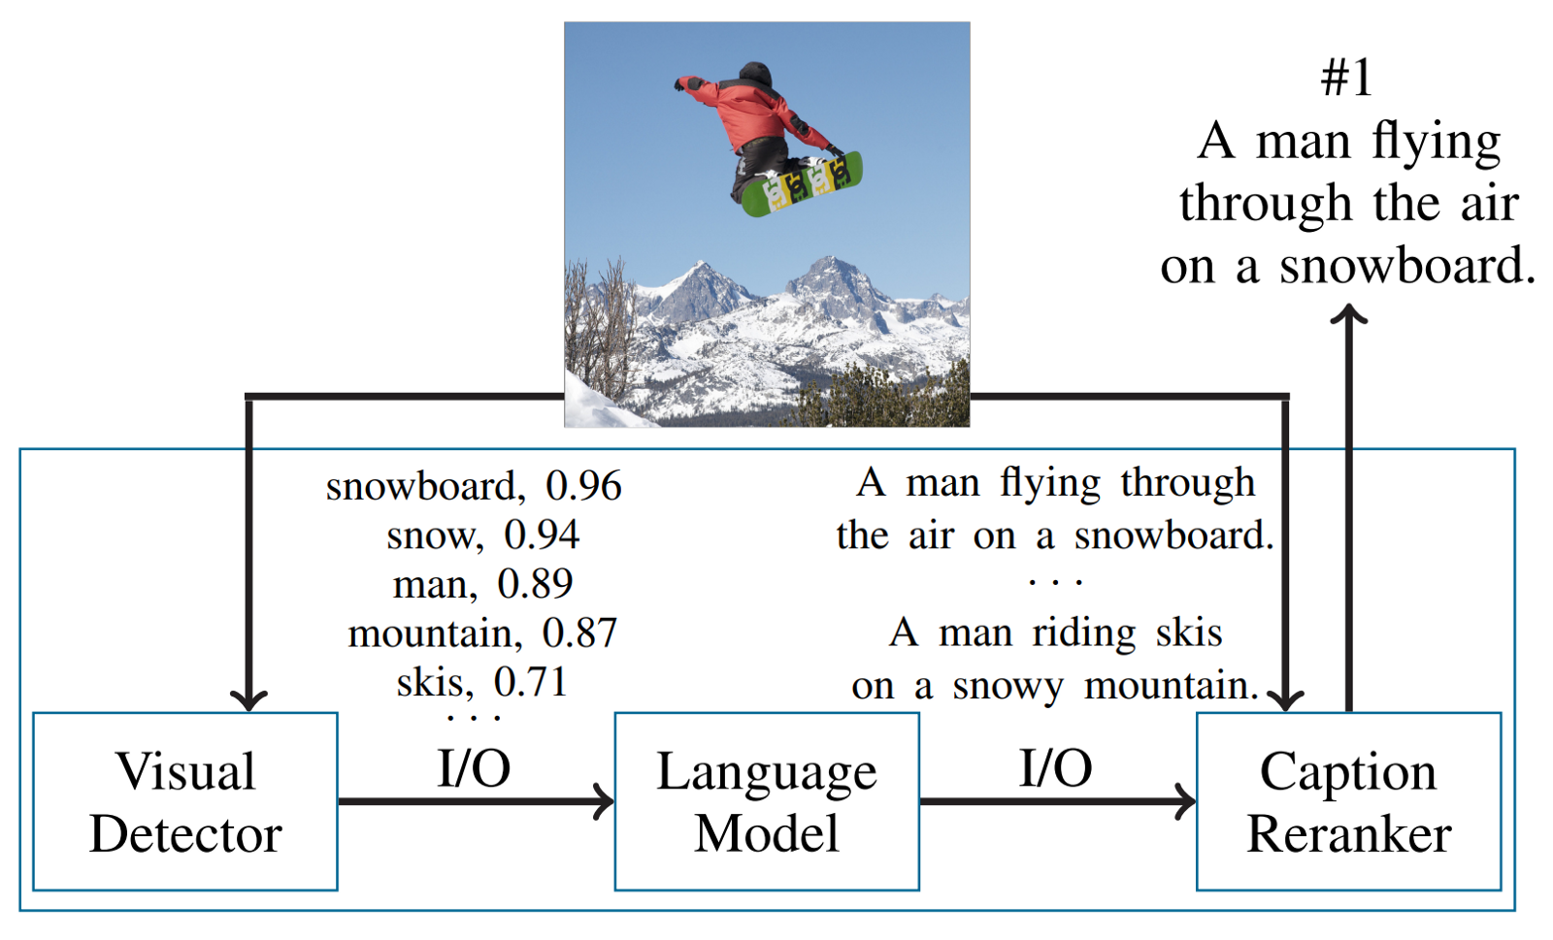
Example: Decomposition for image capturing
Nushi, Besmira, Ece Kamar, Eric Horvitz, and Donald Kossmann. "On human intellect and machine failures: troubleshooting integrative machine learning systems." In Proc. AAAI. 2017.

Slide 64
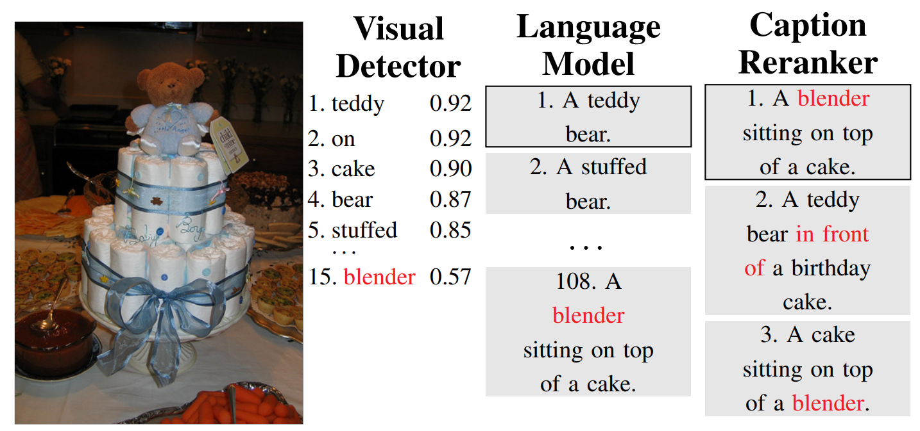
Example: Blaming assignment?!
Nushi, Besmira, Ece Kamar, Eric Horvitz, and Donald Kossmann. "On human intellect and machine failures: troubleshooting integrative machine learning systems." In Proc. AAAI. 2017.

Slide 65
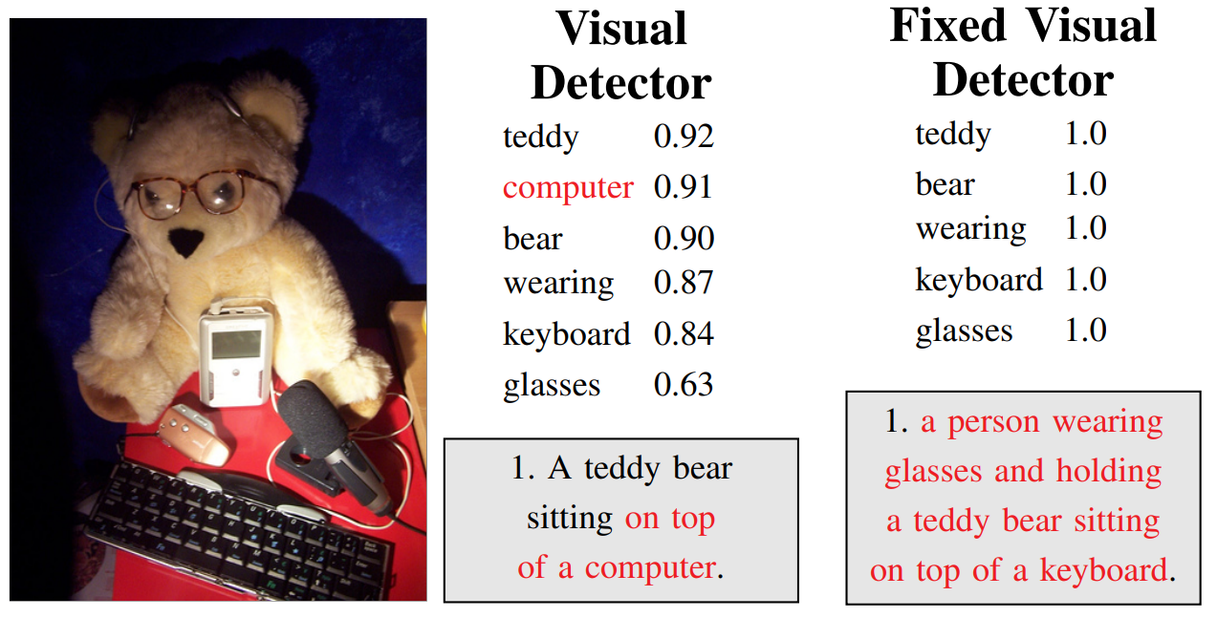
Fixing mistakes may introduce mistakes
Nushi, Besmira, Ece Kamar, Eric Horvitz, and Donald Kossmann. "On human intellect and machine failures: troubleshooting integrative machine learning systems." In Proc. AAAI. 2017.

Slide 66

Questions?

